Slide 1
PADP(18CS73)
Unit 1
Dr. Minal Moharir

Slide 2
Principles of Parallel Algorithm Design
Ananth Grama, Anshul Gupta, George Karypis, and Vipin Kumar
To accompany the text “Introduction to Parallel Computing”,
Addison Wesley, 2003.

Slide 3
Chapter Overview: Algorithms and Concurrency
Introduction to Parallel Algorithms
  Tasks and Decomposition
  Processes and Mapping
  Processes Versus Processors
Decomposition Techniques
  Recursive Decomposition
  Recursive Decomposition
  Exploratory Decomposition
  Hybrid Decomposition
Characteristics of Tasks and Interactions
  Task Generation, Granularity, and Context
  Characteristics of Task Interactions.

Slide 4
Chapter Overview: Concurrency and Mapping
Mapping Techniques for Load Balancing
  Static and Dynamic Mapping
Methods for Minimizing Interaction Overheads
  Maximizing Data Locality
  Minimizing Contention and Hot-Spots
  Overlapping Communication and Computations
  Replication vs. Communication
  Group Communications vs. Point-to-Point Communication
Parallel Algorithm Design Models
  Data-Parallel, Work-Pool, Task Graph, Master-Slave, Pipeline, and Hybrid Models

Slide 5
Preliminaries: Decomposition, Tasks, and
Dependency Graphs
The first step in developing a parallel algorithm is to decompose the problem into tasks that can be executed concurrently
A given problem may be docomposed into tasks in many different ways.
Tasks may be of same, different, or even interminate sizes.
A decomposition can be illustrated in the form of a directed graph with nodes corresponding to tasks and edges indicating that the result of one task is required for processing the next.
Such a graph is called a task dependency graph.

Slide 6
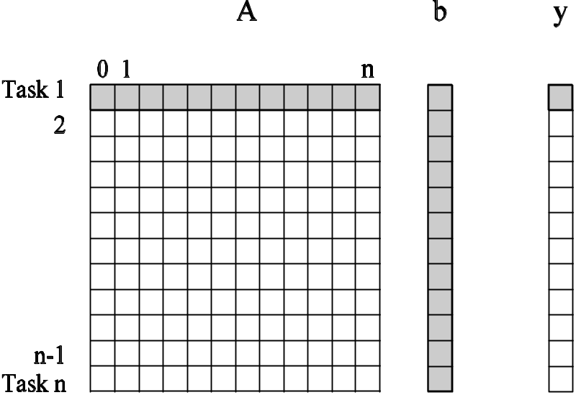
Example: Multiplying a Dense Matrix with a Vector
Computation of each element of output vector y is independent of other elements. Based on this, a dense matrix-vector product can be decomposed into n tasks. The figure highlights the portion of the matrix and vector accessed by Task 1.
Observations: While tasks share data (namely, the vector b ), they do not have any control dependencies - i.e., no task needs to wait for the (partial) completion of any other. All tasks are of the same size in terms of number of operations. Is this the maximum number of tasks we could decompose this problem into?

Slide 7
Example: Database Query Processing
Consider the execution of the query:
MODEL = ``CIVIC'' AND YEAR = 2001 AND
(COLOR = ``GREEN'' OR COLOR = ``WHITE)
on the following database:
ID# | Model | Year | Color | Dealer | Price
4523 | Civic | 2002 | Blue | MN | $18,000
3476 | Corolla | 1999 | White | IL | $15,000
7623 | Camry | 2001 | Green | NY | $21,000
9834 | Prius | 2001 | Green | CA | $18,000
6734 | Civic | 2001 | White | OR | $17,000
5342 | Altima | 2001 | Green | FL | $19,000
3845 | Maxima | 2001 | Blue | NY | $22,000
8354 | Accord | 2000 | Green | VT | $18,000
4395 | Civic | 2001 | Red | CA | $17,000
7352 | Civic | 2002 | Red | WA | $18,000

Slide 8
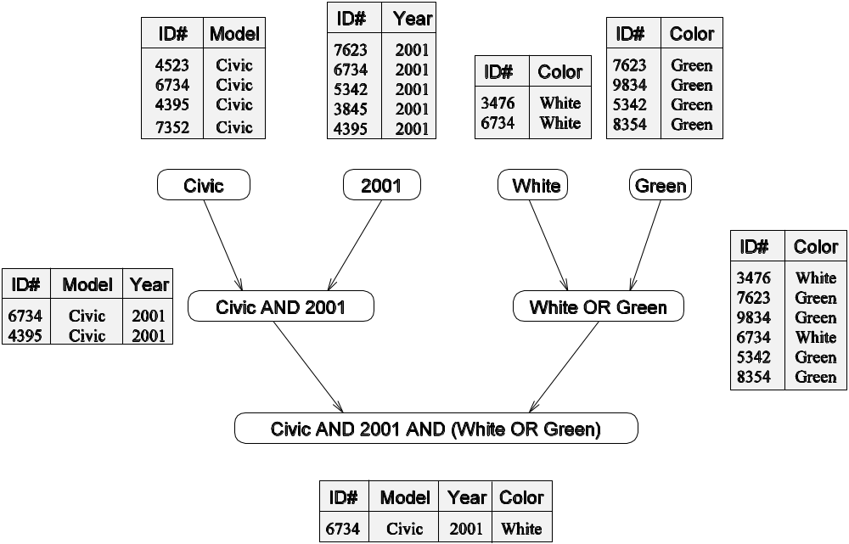
Example: Database Query Processing
The execution of the query can be divided into subtasks in various
ways. Each task can be thought of as generating an intermediate
table of entries that satisfy a particular clause.
Decomposing the given query into a number of tasks.
Edges in this graph denote that the output of one task
is needed to accomplish the next.

Slide 9
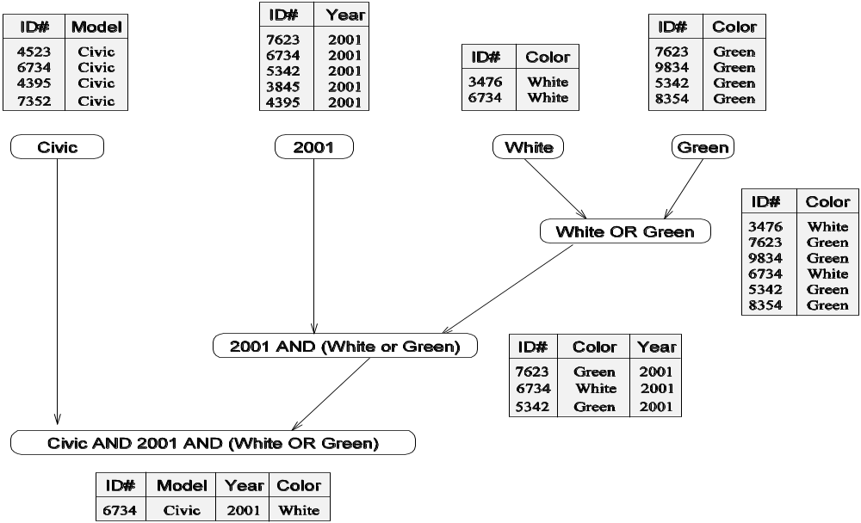
Example: Database Query Processing
Note that the same problem can be decomposed into subtasks in other
ways as well.
An alternate decomposition of the given problem into
subtasks, along with their data dependencies.
Different task decompositions may lead to significant differences with
respect to their eventual parallel performance.

Slide 10
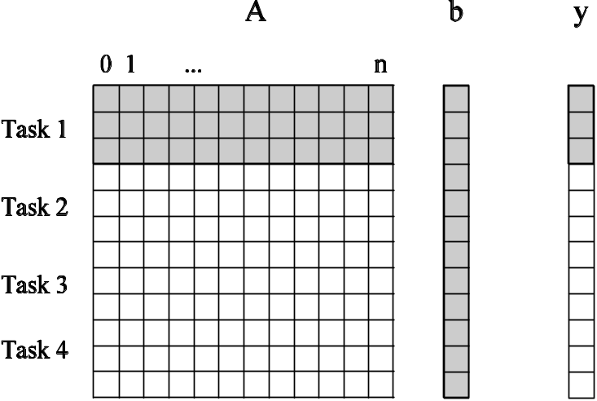
Granularity of Task Decompositions
The number of tasks into which a problem is decomposed determines its granularity.
Decomposition into a large number of tasks results in fine-grained decomposition and that into a small number of tasks results in a coarse grained decomposition.
A coarse grained counterpart to the dense matrix-vector product example. Each task in this example corresponds to the computation of three elements of the result vector.

Slide 11
Degree of Concurrency
The number of tasks that can be executed in parallel is the degree of concurrency of a decomposition.
Since the number of tasks that can be executed in parallel may change over program execution, the maximum degree of concurrency is the maximum number of such tasks at any point during execution. What is the maximum degree of concurrency of the database query examples?
The average degree of concurrency is the average number of tasks that can be processed in parallel over the execution of the program.
Assuming that each tasks in the database example takes identical processing time, what is the average degree of concurrency in each decomposition?
The degree of concurrency increases as the decomposition becomes finer in granularity and vice versa.

Slide 12
Critical Path Length
A directed path in the task dependency graph represents a sequence of tasks that must be processed one after the other.
The longest such path determines the shortest time in which the program can be executed in parallel.
The length of the longest path in a task dependency graph is called the critical path length.

Slide 13
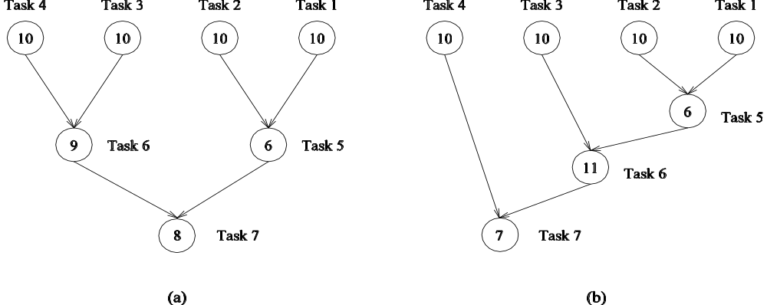
Critical Path Length
Consider the task dependency graphs of the two database query
decompositions:
What are the critical path lengths for the two task dependency graphs?
If each task takes 10 time units, what is the shortest parallel execution time
for each decomposition? How many processors are needed in each case to
achieve this minimum parallel execution time? What is the maximum
degree of concurrency?

Slide 14
maximum degree of concurrency
In most cases, the maximum degree of concurrency is less than the total number of tasks due to dependencies among the tasks.
For example, the maximum degree of concurrency in the task-graphs of Figures 3.2 and 3.3 is four. In these task-graphs, maximum concurrency is available right at the beginning when tables for Model, Year, Color Green, and Color White can be computed simultaneously. In general,
for task_x0002_dependency graphs that are trees, the maximum degree of concurrency is always equal to the number of leaves in the tree.

Slide 15
average degree of concurrency
The degree of concurrency also depends on the shape of the task-dependency graph and the same granularity, in general, does not guarantee the same degree of concurrency.
For example, consider the two task graphs in Figure 3.5, which are abstractions of the task graphs of Figures 3.2 and 3.3, respectively
The number inside each node represents the amount of work required to complete the task corresponding to that node.
The average degree of concurrency of the task graph in Figure 3.5(a) is 2.33 and that of the task graph in Figure 3.5(b) is 1.88

Slide 16
average degree of concurrency
Phase 1: Task 1, Task 2, Task 3 and Task 4 can be executed parallelly (if you have more than 3 processors). So the degree of concurrency in this phase is the sum of the weights of those four nodes: 10+10+10+10 = 40.
Phase 2: Task 6 and Task 5 can be executed parallelly (if you have more than 1 processor). So the degree of concurrency in this phase is: 9+6 = 15.
Phase 3: You can execute only Task 7, so the degree of concurrency here is 8.
The maximum number of concurrency is max(40, 15, 8) = 40. The average degree of concurrency is (40+15+8)/(10+9+8) = 63/27.

Slide 17
average degree of concurrency
Graph b:
Phase 1: Task 1, Task 2, Task 3 and Task 4 can be executed parallelly (if you have more than 3 processors). So the degree of concurrency in this phase is: 10+10+10+10 = 40.
Phase 2: You can execute only Task 5, so the degree of concurrency here is 6.
Phase 3: You can execute only Task 6, so the degree of concurrency here is 11.
Phase 4: You can execute only Task 7, so the degree of concurrency here is 7.
The maximum number of concurrency is max(40, 6, 11, 7) = 40. The average degree of concurrency is (40+6+11+7)/(10+6+11+7) = 64/34

Slide 18
average degree of concurrency
The ratio of the total amount of work to the critical-path length is the average degree of concurrency.
Therefore, a shorter critical path favors a higher degree of concurrency.
For example, the critical path length is 27 in the task-dependency graph shown in Figure 3.5(a) and s 34 in the task-dependency graph shown in Figure 3.5(b).
Since the total amount of work required to solve the problems using the two decompositions is 63 and 64, respectively, the average degree of concurrency of the two task-dependency graphs is 2.33 and 1.88, respectively.

Slide 19
Limits on Parallel Performance
It would appear that the parallel time can be made arbitrarily small by making the decomposition finer in granularity.
There is an inherent bound on how fine the granularity of a computation can be. For example, in the case of multiplying a dense matrix with a vector, there can be no more than (n²) concurrent tasks.
Concurrent tasks may also have to exchange data with other tasks. This results in communication overhead. The tradeoff between the granularity of a decomposition and associated overheads often determines performance bounds.

Slide 20
Task Interaction Graphs
Subtasks generally exchange data with others in a decomposition. For example, even in the trivial decomposition of the dense matrix-vector product, if the vector is not replicated across all tasks, they will have to communicate elements of the vector.
The graph of tasks (nodes) and their interactions/data exchange (edges) is referred to as a task interaction graph.
Note that task interaction graphs represent data dependencies, whereas task dependency graphs represent control dependencies.

Slide 21
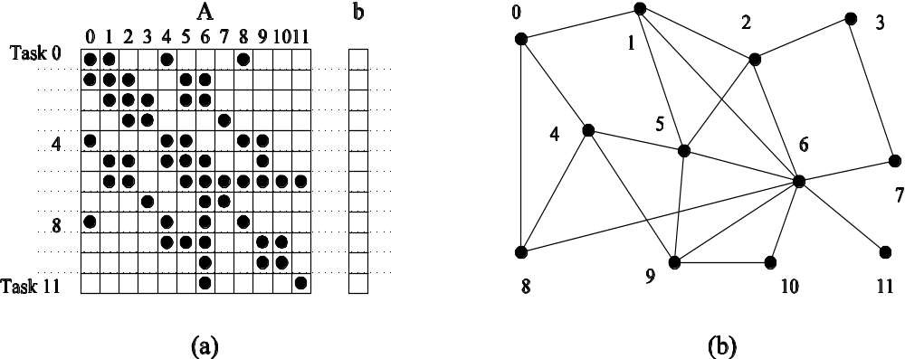
Task Interaction Graphs: An Example
Consider the problem of multiplying a sparse matrix A with a vector b. The following observations can be made:
As before, the computation of each element of the result vector can be viewed as an independent task.
Unlike a dense matrix-vector product though, only non-zero elements of matrix A participate in the computation.
If, for memory optimality, we also partition b across tasks, then one can see that the task interaction graph of the computation is identical to the graph of the matrix A (the graph for which A represents the adjacency structure).

Slide 22
Task Interaction Graphs, Granularity, and Communication
In general, if the granularity of a decomposition is finer, the associated overhead (as a ratio of useful work assocaited with a task) increases.
Example: Consider the sparse matrix-vector product example from previous foil. Assume that each node takes unit time to process and each interaction (edge) causes an overhead of a unit time.
Viewing node 0 as an independent task involves a useful computation of one time unit and overhead (communication) of three time units.
Now, if we consider nodes 0, 4, and 5 as one task, then the task has useful computation totaling to three time units and communication corresponding to four time units (four edges). Clearly, this is a more favorable ratio than the former case.

Slide 23
Processes and Mapping
In general, the number of tasks in a decomposition exceeds the number of processing elements available.
For this reason, a parallel algorithm must also provide a mapping of tasks to processes.
Note: We refer to the mapping as being from tasks to processes, as opposed to processors. This is because typical programming APIs, as we shall see, do not allow easy binding of tasks to physical processors. Rather, we aggregate tasks into processes and rely on the system to map these processes to physical processors. We use processes, not in the UNIX sense of a process, rather, simply as a collection of tasks and associated data.

Slide 24
Processes and Mapping
Appropriate mapping of tasks to processes is critical to the parallel performance of an algorithm.
Mappings are determined by both the task dependency and task interaction graphs.
Task dependency graphs can be used to ensure that work is equally spread across all processes at any point (minimum idling and optimal load balance).
Task interaction graphs can be used to make sure that processes need minimum interaction with other processes (minimum communication).

Slide 25
Processes and Mapping
An appropriate mapping must minimize parallel execution time by:
Mapping independent tasks to different processes.
Assigning tasks on critical path to processes as soon as they become available.
Minimizing interaction between processes by mapping tasks with dense interactions to the same process.
Note: These criteria often conflict eith each other. For example, a decomposition into one task (or no decomposition at all) minimizes interaction but does not result in a speedup at all! Can you think of other such conflicting cases?

Slide 26
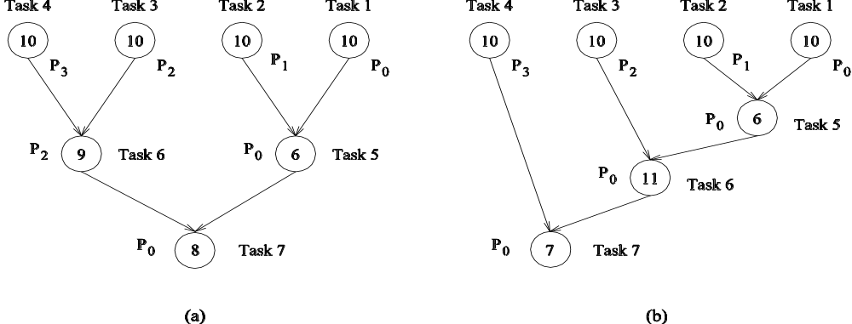
Processes and Mapping: Example
Mapping tasks in the database query decomposition to processes. These mappings were arrived at by viewing the dependency graph in terms of levels (no two nodes in a level have dependencies). Tasks within a single level are then assigned to different processes.

Slide 27
Decomposition Techniques
So how does one decompose a task into various subtasks?
While there is no single recipe that works for all problems, we present a set of commonly used techniques that apply to broad classes of problems. These include:
• recursive decomposition
• data decomposition
• exploratory decomposition
• speculative decomposition

Slide 28
Recursive Decomposition
Generally suited to problems that are solved using the divide-and-conquer strategy.
A given problem is first decomposed into a set of sub-problems.
These sub-problems are recursively decomposed further until a desired granularity is reached.

Slide 29
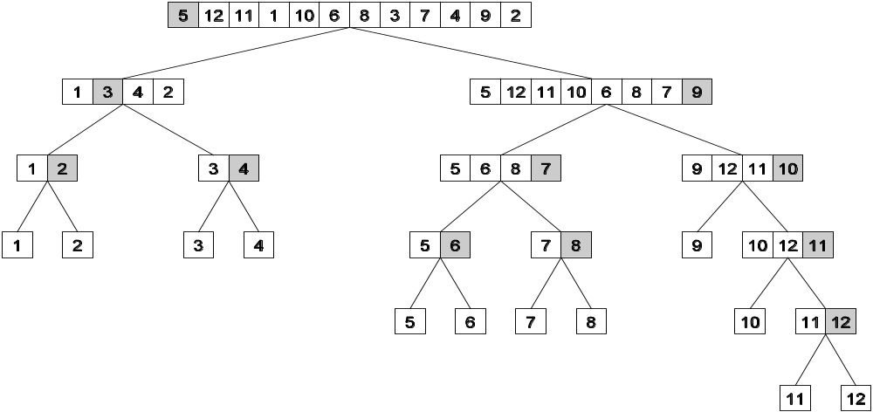
Recursive Decomposition: Example
A classic example of a divide-and-conquer algorithm on which we
can apply recursive decomposition is Quicksort.
In this example, once the list has been partitioned around the pivot, each sublist can be processed concurrently (i.e., each sublist represents an independent subtask). This can be repeated recursively.

Slide 30
Recursive Decomposition: Example
The problem of finding the minimum number in a given list (or indeed any other associative operation such as sum, AND, etc.) can be fashioned as a divide-and-conquer algorithm. The following algorithm illustrates this.
We first start with a simple serial loop for computing the minimum entry in a given list:
1. procedure SERIAL_MIN (A, n)
2. begin
3. min = A[0];
4. for i := 1 to n − 1 do
5. if (A[i] < min) min := A[i];
6. endfor;
7. return min;
8. end SERIAL_MIN

Slide 31
Recursive Decomposition: Example
We can rewrite the loop as follows:
1. procedure RECURSIVE_MIN (A, n)
2. begin
3. if ( n = 1 ) then
4. min := A [0] ;
5. else
6. lmin := RECURSIVE_MIN ( A, n/2 );
7. rmin := RECURSIVE_MIN ( &(A[n/2]), n - n/2 );
8. if (lmin < rmin) then
9. min := lmin;
10. else
11. min := rmin;
12. endelse;
13. endelse;
14. return min;
15. end RECURSIVE_MIN

Slide 32
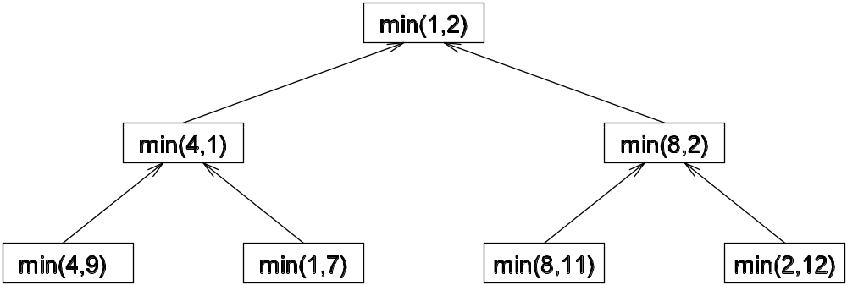
Recursive Decomposition: Example
The code in the previous foil can be decomposed naturally using a recursive decomposition strategy. We illustrate this with the following example of finding the minimum number in the set {4, 9, 1, 7, 8, 11, 2, 12}. The task dependency graph associated with this computation is as follows:

Slide 33
Data Decomposition
Identify the data on which computations are performed.
Partition this data across various tasks.
This partitioning induces a decomposition of the problem.
Data can be partitioned in various ways - this critically impacts performance of a parallel algorithm.

Slide 34
Data Decomposition: Output Data Decomposition
Often, each element of the output can be computed independently of others (but simply as a function of the input).
A partition of the output across tasks decomposes the problem naturally.

Slide 35
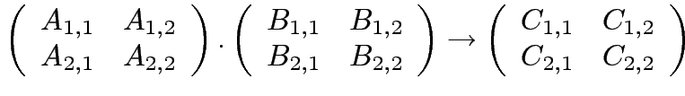




Output Data Decomposition: Example
Consider the problem of multiplying two n x n matrices A and B to yield matrix C. The output matrix C can be partitioned into four tasks as follows:
Task 1:
Task 2:
Task 3:
Task 4:

Slide 36
Output Data Decomposition: Example
A partitioning of output data does not result in a unique decomposition into tasks. For example, for the same problem as in previus foil, with identical output data distribution, we can derive the following two (other) decompositions:
Decomposition I | Decomposition II
Task 1: C_{1,1} = A_{1,1} B_{1,1} Task 2: C_{1,1} = C_{1,1} + A_{1,2} B_{2,1} Task 3: C_{1,2} = A_{1,1} B_{1,2} Task 4: C_{1,2} = C_{1,2} + A_{1,2} B_{2,2} Task 5: C_{2,1} = A_{2,1} B_{1,1} Task 6: C_{2,1} = C_{2,1} + A_{2,2} B_{2,1} Task 7: C_{2,2} = A_{2,1} B_{1,2} Task 8: C_{2,2} = C_{2,2} + A_{2,2} B_{2,2} | Task 1: C_{1,1} = A_{1,1} B_{1,1} Task 2: C_{1,1} = C_{1,1} + A_{1,2} B_{2,1} Task 3: C_{1,2} = A_{1,2} B_{2,2} Task 4: C_{1,2} = C_{1,2} + A_{1,1} B_{1,2} Task 5: C_{2,1} = A_{2,2} B_{2,1} Task 6: C_{2,1} = C_{2,1} + A_{2,1} B_{1,1} Task 7: C_{2,2} = A_{2,1} B_{1,2} Task 8: C_{2,2} = C_{2,2} + A_{2,2} B_{2,2}

Slide 37
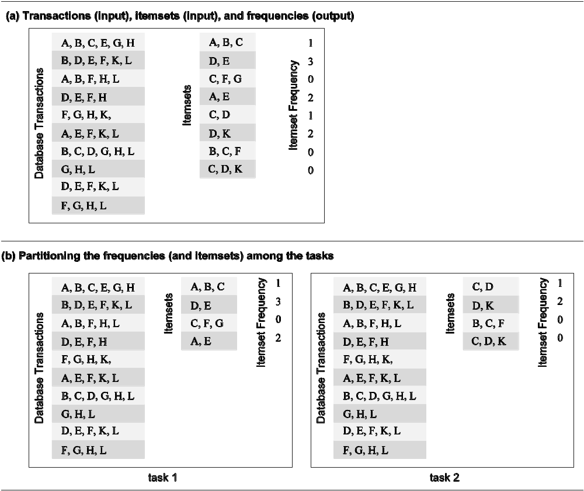
Output Data Decomposition: Example
Consider the problem of counting the instances of given itemsets in a database of transactions. In this case, the output (itemset frequencies) can be partitioned across tasks.

Slide 38
Output Data Decomposition: Example
From the previous example, the following observations can be made:
If the database of transactions is replicated across the processes, each task can be independently accomplished with no communication.
If the database is partitioned across processes as well (for reasons of memory utilization), each task first computes partial counts. These counts are then aggregated at the appropriate task.

Slide 39
Input Data Partitioning
Generally applicable if each output can be naturally computed as a function of the input.
In many cases, this is the only natural decomposition because the output is not clearly known a-priori (e.g., the problem of finding the minimum in a list, sorting a given list, etc.).
A task is associated with each input data partition. The task performs as much of the computation with its part of the data. Subsequent processing combines these partial results.

Slide 40
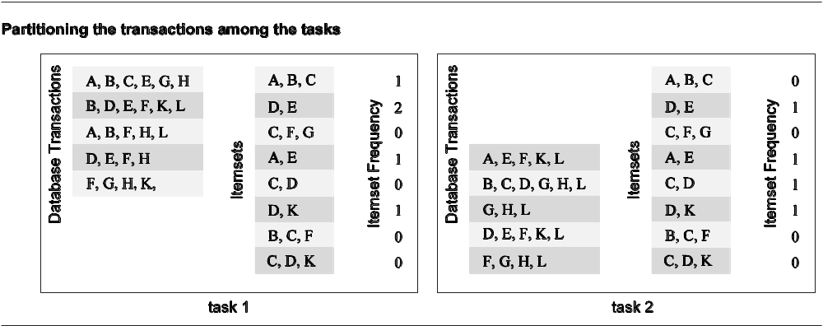
Input Data Partitioning: Example
In the database counting example, the input (i.e., the transaction set) can be partitioned. This induces a task decomposition in which each task generates partial counts for all itemsets. These are combined subsequently for aggregate counts.

Slide 41
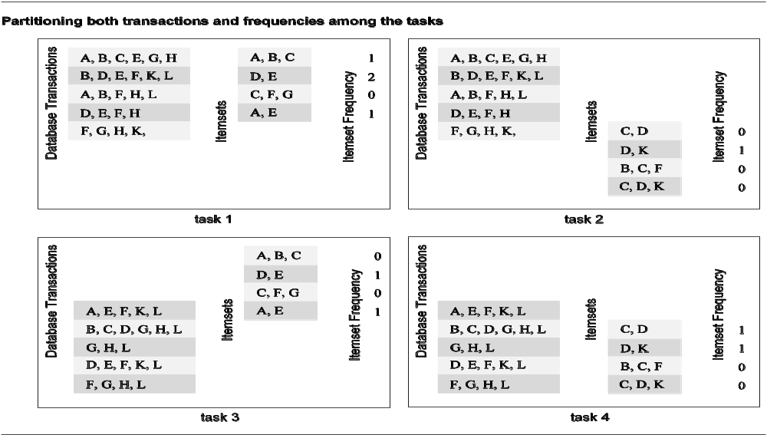
Partitioning Input and Output Data
Often input and output data decomposition can be combined for a higher degree of concurrency. For the itemset counting example, the transaction set (input) and itemset counts (output) can both be decomposed as follows:

Slide 42
Intermediate Data Partitioning
Computation can often be viewed as a sequence of transformation from the input to the output data.
In these cases, it is often beneficial to use one of the intermediate stages as a basis for decomposition.

Slide 43
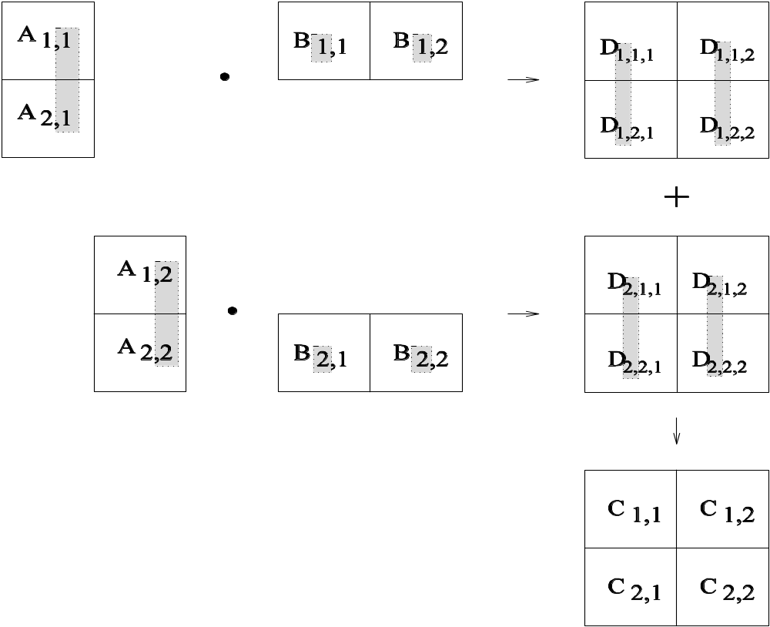
Intermediate Data Partitioning: Example
Let us revisit the example of dense matrix multiplication. We first show how we can visualize this computation in terms of intermediate matrices D.

Slide 44
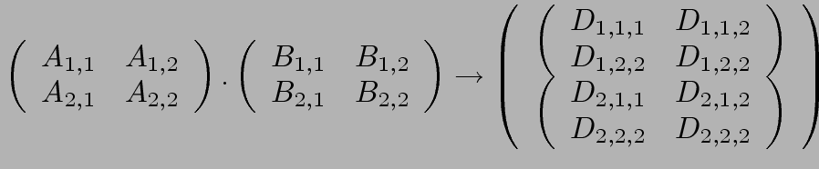
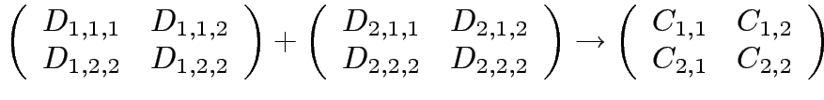
Intermediate Data Partitioning: Example
A decomposition of intermediate data structure leads to the following decomposition into 8 + 4 tasks:
Stage I
Stage II
Task 01: D_{1,1,1}= A_{1,1} B_{1,1} | Task 02: D_{2,1,1}= A_{1,2} B_{2,1}
Task 03: D_{1,1,2}= A_{1,1} B_{1,2} | Task 04: D_{2,1,2}= A_{1,2} B_{2,2}
Task 05: D_{1,2,1}= A_{2,1} B_{1,1} | Task 06: D_{2,2,1}= A_{2,2} B_{2,1}
Task 07: D_{1,2,2}= A_{2,1} B_{1,2} | Task 08: D_{2,2,2}= A_{2,2} B_{2,2}
Task 09: C_{1,1} = D_{1,1,1} + D_{2,1,1} | Task 10: C_{1,2} = D_{1,1,2} + D_{2,1,2}
Task 11: C_{2,1} = D_{1,2,1} + D_{2,2,1} | Task 12: C_{2,,2} = D_{1,2,2} + D_{2,2,2}

Slide 45
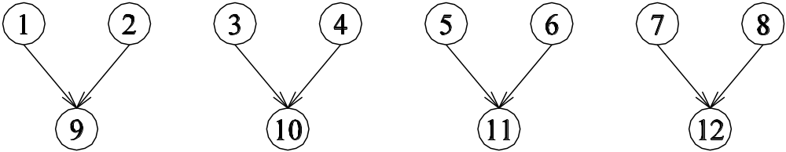
Intermediate Data Partitioning: Example
The task dependency graph for the decomposition (shown in previous foil) into 12 tasks is as follows:

Slide 46
The Owner Computes Rule
The Owner Computes Rule generally states that the process assined a particular data item is responsible for all computation associated with it.
In the case of input data decomposition, the owner computes rule imples that all computations that use the input data are performed by the process.
In the case of output data decomposition, the owner computes rule implies that the output is computed by the process to which the output data is assigned.

Slide 47
Exploratory Decomposition
In many cases, the decomposition of the problem goes hand-in-hand with its execution.
These problems typically involve the exploration (search) of a state space of solutions.
Problems in this class include a variety of discrete optimization problems (0/1 integer programming, QAP, etc.), theorem proving, game playing, etc.

Slide 48
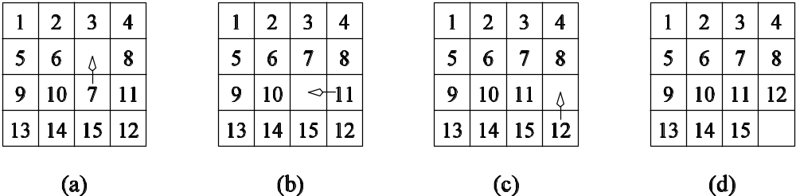
Exploratory Decomposition: Example
A simple application of exploratory decomposition is in the solution to a 15 puzzle (a tile puzzle). We show a sequence of three moves that transform a given initial state (a) to desired final state (d).
Of-course, the problem of computing the solution, in general, is much more difficult than in this simple example.

Slide 49
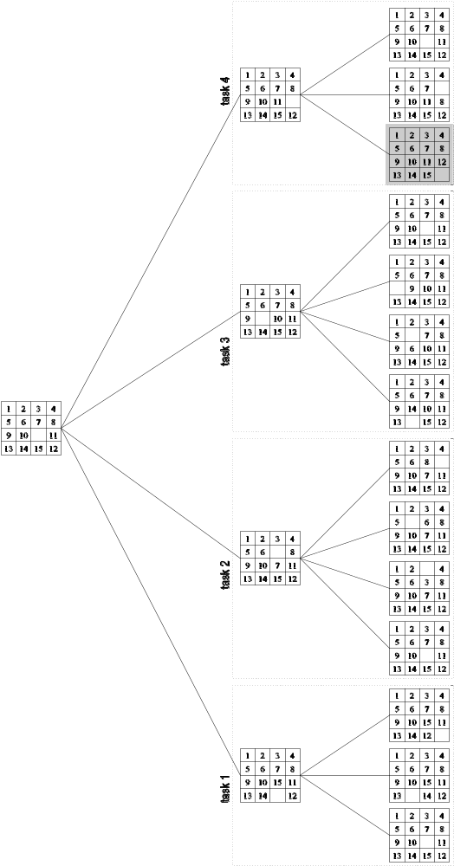
Exploratory Decomposition: Example
The state space can be explored by generating various successor states of the current state and to view them as independent tasks.

Slide 50
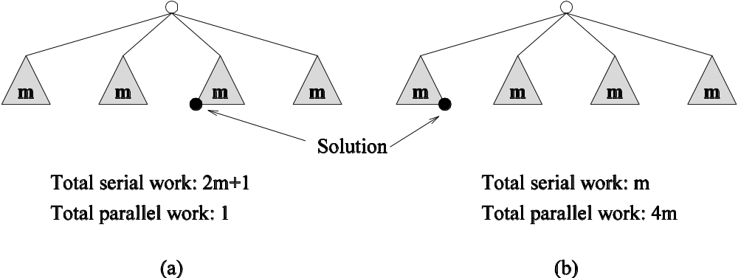
Exploratory Decomposition: Anomalous Computations
In many instances of exploratory decomposition, the decomposition technique may change the amount of work done by the parallel formulation.
This change results in super- or sub-linear speedups.

Slide 51
Speculative Decomposition
In some applications, dependencies between tasks are not known a-priori.
For such applications, it is impossible to identify independent tasks.
There are generally two approaches to dealing with such applications: conservative approaches, which identify independent tasks only when they are guaranteed to not have dependencies, and, optimistic approaches, which schedule tasks even when they may potentially be erroneous.
Conservative approaches may yield little concurrency and optimistic approaches may require roll-back mechanism in the case of an error.

Slide 52
Speculative Decomposition: Example
A classic example of speculative decomposition is in discrete event simulation.
The central data structure in a discrete event simulation is a time-ordered event list.
Events are extracted precisely in time order, processed, and if required, resulting events are inserted back into the event list.
Consider your day today as a discrete event system - you get up, get ready, drive to work, work, eat lunch, work some more, drive back, eat dinner, and sleep.
Each of these events may be processed independently, however, in driving to work, you might meet with an unfortunate accident and not get to work at all.
Therefore, an optimistic scheduling of other events will have to be rolled back.

Slide 53
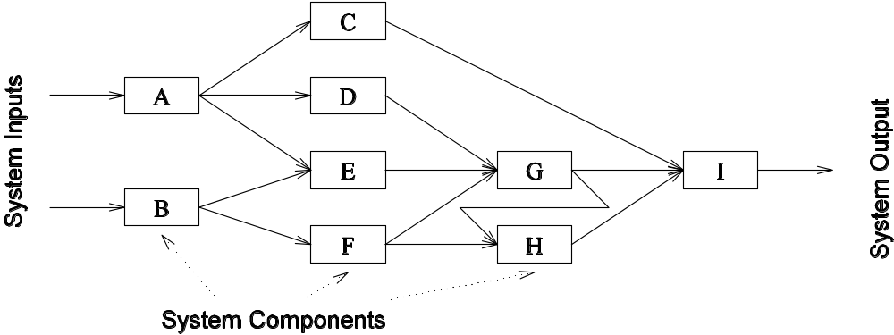
Speculative Decomposition: Example
Another example is the simulation of a network of nodes (for instance, an assembly line or a computer network through which packets pass). The task is to simulate the behavior of this network for various inputs and node delay parameters (note that networks may become unstable for certain values of service rates, queue sizes, etc.).

Slide 54
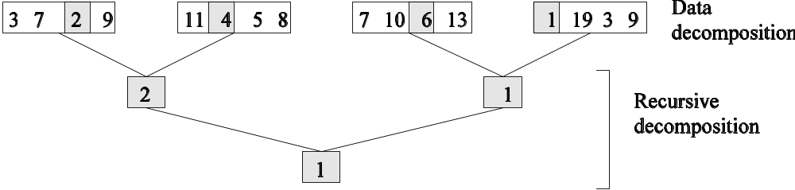
Hybrid Decompositions
Often, a mix of decomposition techniques is necessary for decomposing a problem. Consider the following examples:
In quicksort, recursive decomposition alone limits concurrency (Why?). A mix of data and recursive decompositions is more desirable.
In discrete event simulation, there might be concurrency in task processing. A mix of speculative decomposition and data decomposition may work well.
Even for simple problems like finding a minimum of a list of numbers, a mix of data and recursive decomposition works well.

Slide 55
Characteristics of Tasks
Once a problem has been decomposed into independent tasks, the characteristics of these tasks critically impact choice and performance of parallel algorithms. Relevant task characteristics include:
Task generation.
Task sizes.
Size of data associated with tasks.

Slide 56
Task Generation
Static task generation: Concurrent tasks can be identified a-priori. Typical matrix operations, graph algorithms, image processing applications, and other regularly structured problems fall in this class. These can typically be decomposed using data or recursive decomposition techniques.
Dynamic task generation: Tasks are generated as we perform computation. A classic example of this is in game playing - each 15 puzzle board is generated from the previous one. These applications are typically decomposed using exploratory or speculative decompositions.

Slide 57
Task Sizes
Task sizes may be uniform (i.e., all tasks are the same size) or non-uniform.
Non-uniform task sizes may be such that they can be determined (or estimated) a-priori or not.
Examples in this class include discrete optimization problems, in which it is difficult to estimate the effective size of a state space.

Slide 58
Size of Data Associated with Tasks
The size of data associated with a task may be small or large when viewed in the context of the size of the task.
A small context of a task implies that an algorithm can easily communicate this task to other processes dynamically (e.g., the 15 puzzle).
A large context ties the task to a process, or alternately, an algorithm may attempt to reconstruct the context at another processes as opposed to communicating the context of the task (e.g., 0/1 integer programming).

Slide 59
Characteristics of Task Interactions
Tasks may communicate with each other in various ways. The associated dichotomy is:
Static interactions: The tasks and their interactions are known a-priori. These are relatively simpler to code into programs.
Dynamic interactions: The timing or interacting tasks cannot be determined a-priori. These interactions are harder to code, especitally, as we shall see, using message passing APIs.

Slide 60
Characteristics of Task Interactions
Regular interactions: There is a definite pattern (in the graph sense) to the interactions. These patterns can be exploited for efficient implementation.
Irregular interactions: Interactions lack well-defined topologies.

Slide 61
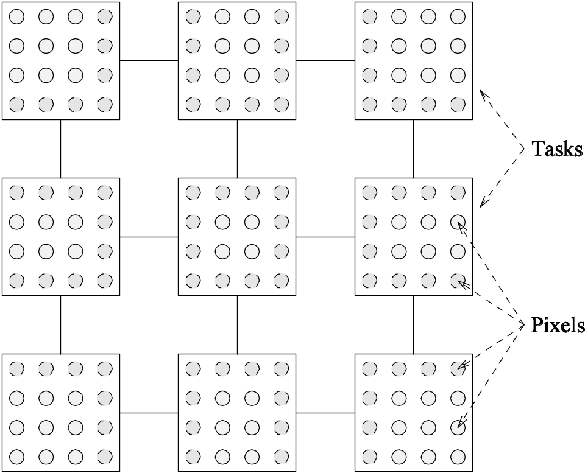
Characteristics of Task Interactions: Example
A simple example of a regular static interaction pattern is in image dithering. The underlying communication pattern is a structured (2-D mesh) one as shown here:

Slide 62

Characteristics of Task Interactions: Example
The multiplication of a sparse matrix with a vector is a good example of a static irregular interaction pattern. Here is an example of a sparse matrix and its associated interaction pattern.

Slide 63
Characteristics of Task Interactions
Interactions may be read-only or read-write.
In read-only interactions, tasks just read data items associated with other tasks.
In read-write interactions tasks read, as well as modily data items associated with other tasks.
In general, read-write interactions are harder to code, since they require additional synchronization primitives.

Slide 64
Characteristics of Task Interactions
Interactions may be one-way or two-way.
A one-way interaction can be initiated and accomplished by one of the two interacting tasks.
A two-way interaction requires participation from both tasks involved in an interaction.
One way interactions are somewhat harder to code in message passing APIs.

Slide 65
Mapping Techniques
Once a problem has been decomposed into concurrent tasks, these must be mapped to processes (that can be executed on a parallel platform).
Mappings must minimize overheads.
Primary overheads are communication and idling.
Minimizing these overheads often represents contradicting objectives.
Assigning all work to one processor trivially minimizes communication at the expense of significant idling.

Slide 66
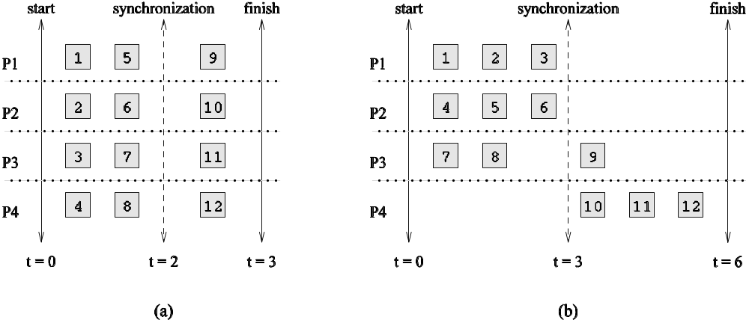
Mapping Techniques for Minimum Idling
Mapping must simultaneously minimize idling and load balance. Merely balancing load does not minimize idling.

Slide 67
Mapping Techniques for Minimum Idling
Mapping techniques can be static or dynamic.
Static Mapping: Tasks are mapped to processes a-priori. For this to work, we must have a good estimate of the size of each task. Even in these cases, the problem may be NP complete.
Dynamic Mapping: Tasks are mapped to processes at runtime. This may be because the tasks are generated at runtime, or that their sizes are not known.
Other factors that determine the choice of techniques include the
size of data associated with a task and the nature of underlying
domain.

Slide 68
Schemes for Static Mapping
Mappings based on data partitioning.
Mappings based on task graph partitioning.
Hybrid mappings.

Slide 69
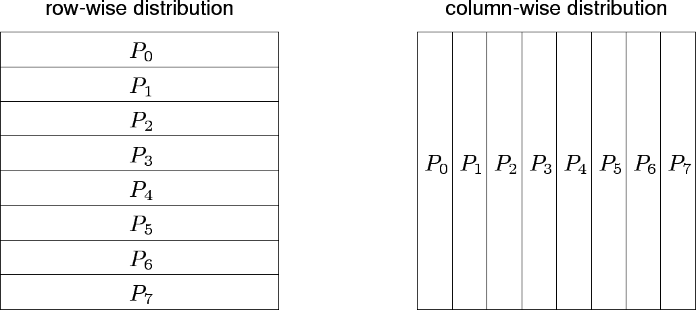
Mappings Based on Data Partitioning
We can combine data partitioning with the ``owner-computes'' rule to partition the computation into subtasks. The simplest data decomposition schemes for dense matrices are 1-D block distribution schemes.

Slide 70
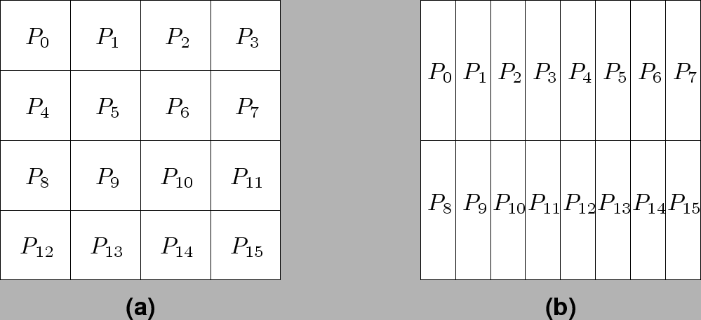
Block Array Distribution Schemes
Block distribution schemes can be generalized to higher dimensions as well.

Slide 71
Block Array Distribution Schemes: Examples
For multiplying two dense matrices A and B, we can partition the output matrix C using a block decomposition.
For load balance, we give each task the same number of elements of C. (Note that each element of C corresponds to a single dot product.)
The choice of precise decomposition (1-D or 2-D) is determined by the associated communication overhead.
In general, higher dimension decomposition allows the use of larger number of processes.

Slide 72
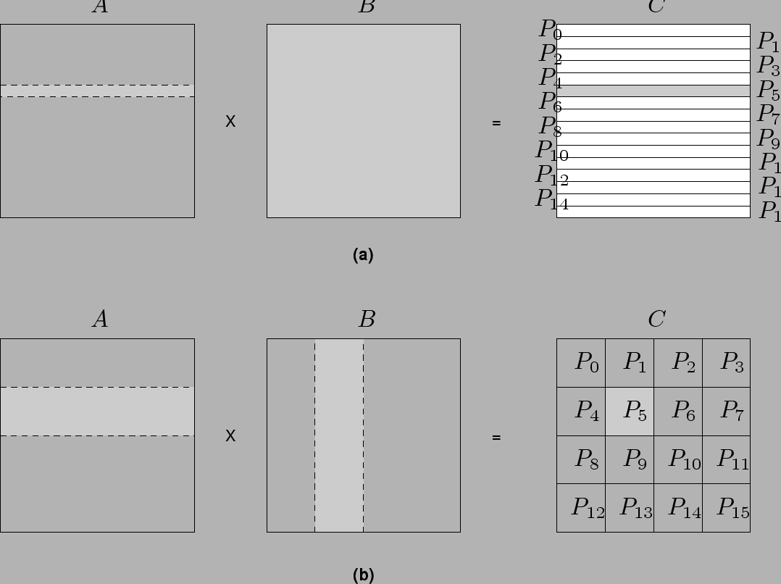
Data Sharing in Dense Matrix Multiplication

Slide 73
Cyclic and Block Cyclic Distributions
If the amount of computation associated with data items varies, a block decomposition may lead to significant load imbalances.
A simple example of this is in LU decomposition (or Gaussian Elimination) of dense matrices.

Slide 74
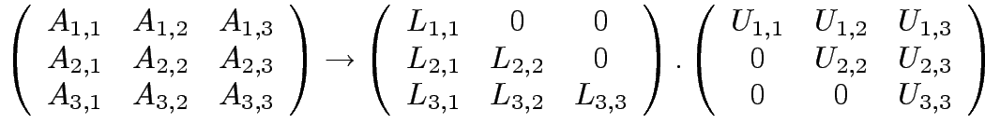














LU Factorization of a Dense Matrix
A decomposition of LU factorization into 14 tasks - notice the
significant load imbalance.
1: 2: 3: 4: 5: | 6: 7: 8: 9: 10: | 11: 12: 13: 14:

Slide 75
Block Cyclic Distributions
Variation of the block distribution scheme that can be used to alleviate the load-imbalance and idling problems.
Partition an array into many more blocks than the number of available processes.
Blocks are assigned to processes in a round-robin manner so that each process gets several non-adjacent blocks.

Slide 76
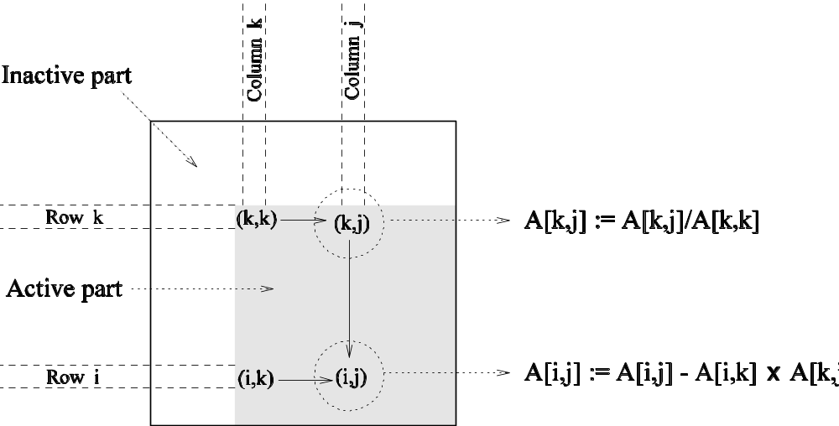
Block-Cyclic Distribution for Gaussian Elimination
The active part of the matrix in Gaussian Elimination changes. By assigning blocks in a block-cyclic fashion, each processor receives blocks from different parts of the matrix.

Slide 77
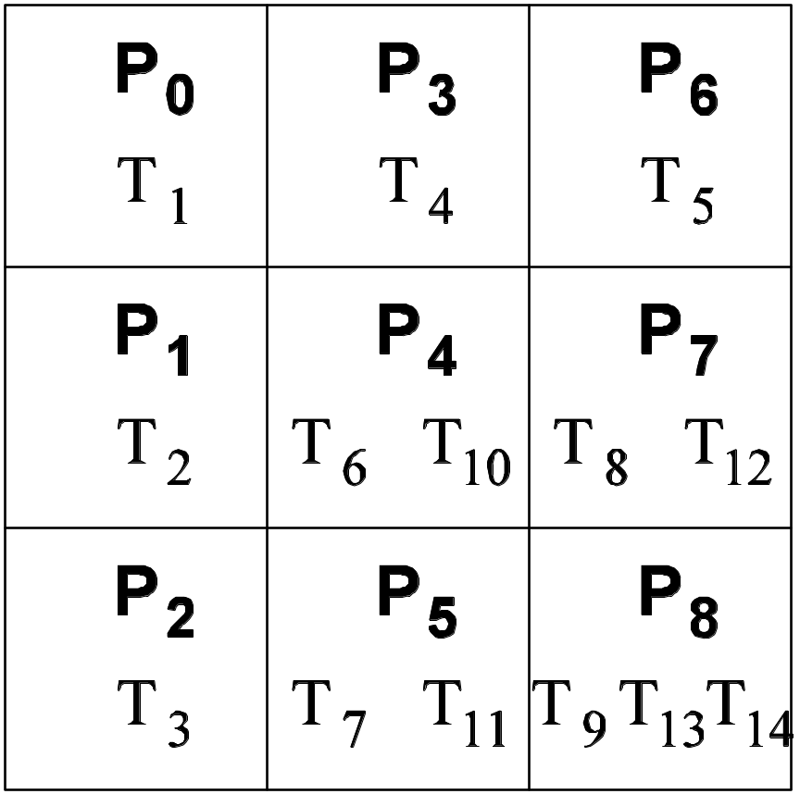
Block-Cyclic Distribution: Examples
One- and two-dimensional block-cyclic distributions among 4 processes.

Slide 78
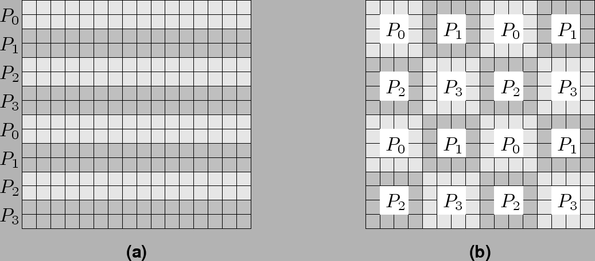
Block-Cyclic Distribution
A cyclic distribution is a special case in which block size is one.
A block distribution is a special case in which block size is n/p , where n is the dimension of the matrix and p is the number of processes.

Slide 79
Graph Partitioning Dased Data Decomposition
In case of sparse matrices, block decompositions are more complex.
Consider the problem of multiplying a sparse matrix with a vector.
The graph of the matrix is a useful indicator of the work (number of nodes) and communication (the degree of each node).
In this case, we would like to partition the graph so as to assign equal number of nodes to each process, while minimizing edge count of the graph partition.

Slide 80

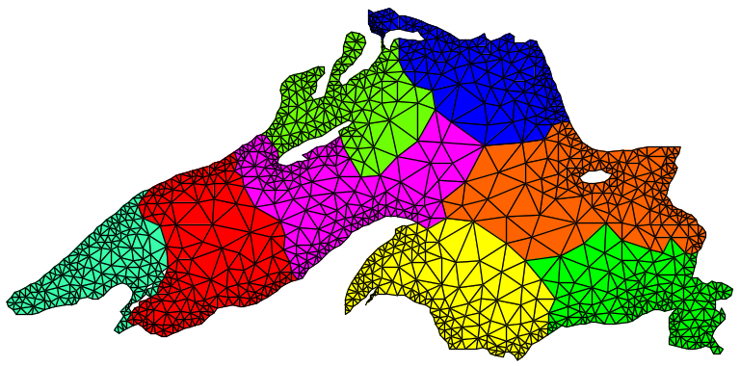
Partitioning the Graph of Lake Superior
Random Partitioning
Partitioning for minimum edge-cut.

Slide 81
Mappings Based on Task Paritioning
Partitioning a given task-dependency graph across processes.
Determining an optimal mapping for a general task-dependency graph is an NP-complete problem.
Excellent heuristics exist for structured graphs.

Slide 82
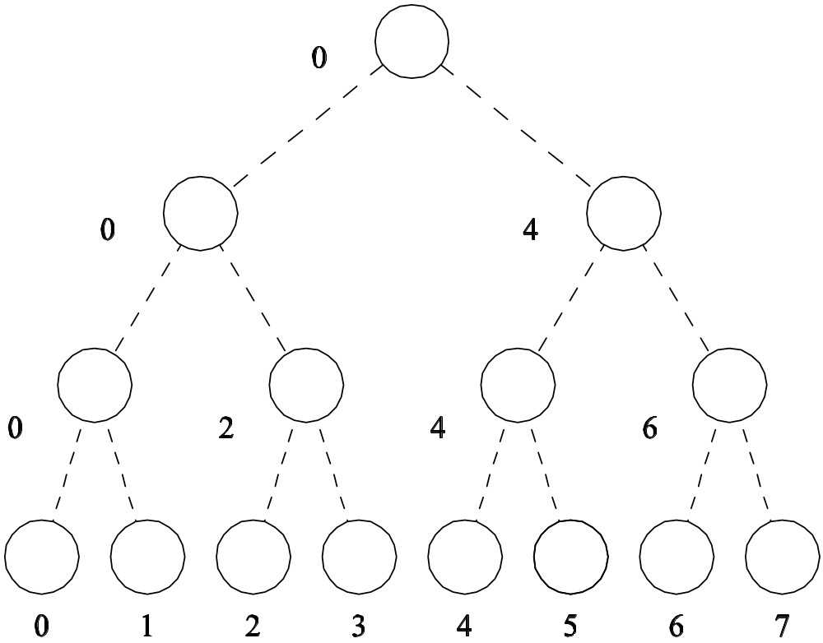
Task Paritioning: Mapping a Binary Tree Dependency Graph
Example illustrates the dependency graph of one view of quick-sort
and how it can be assigned to processes in a hypercube.

Slide 83
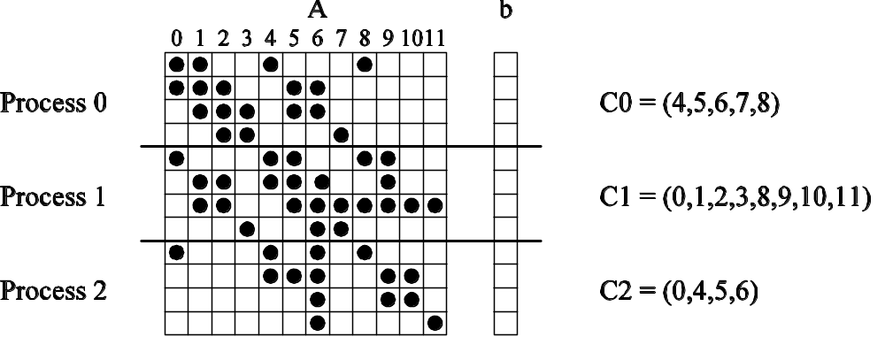
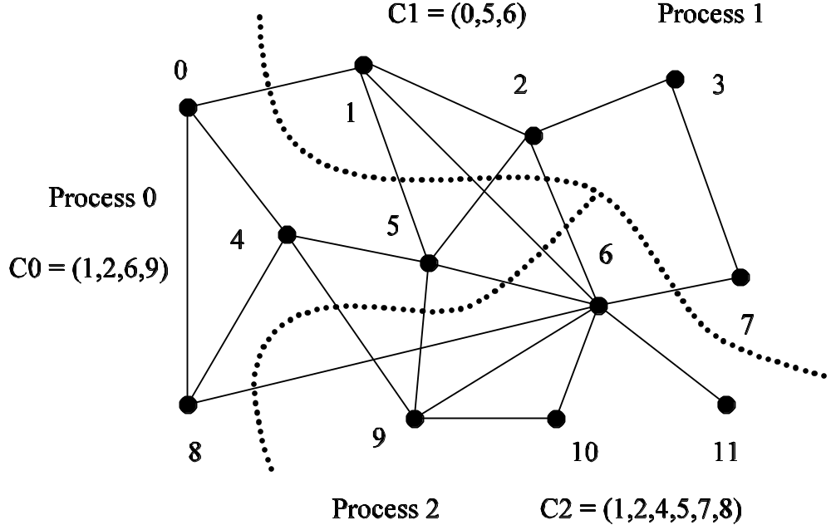
Task Paritioning: Mapping a Sparse Graph
Sparse graph for computing a sparse matrix-vector product and its mapping.

Slide 84
Hierarchical Mappings
Sometimes a single mapping technique is inadequate.
For example, the task mapping of the binary tree (quicksort) cannot use a large number of processors.
For this reason, task mapping can be used at the top level and data partitioning within each level.

Slide 85
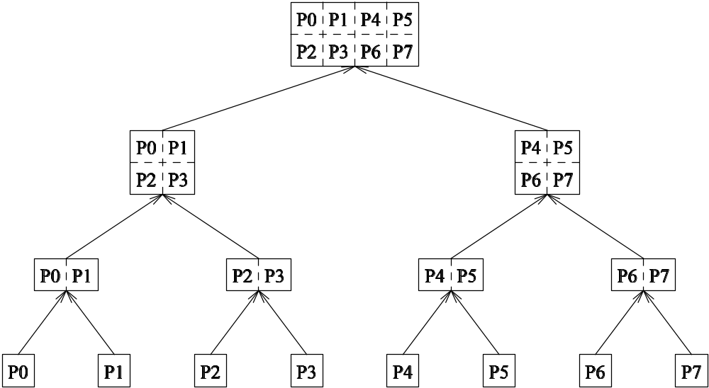
An example of task partitioning at top level with data partitioning at the lower level.

Slide 86
Schemes for Dynamic Mapping
Dynamic mapping is sometimes also referred to as dynamic load balancing, since load balancing is the primary motivation for dynamic mapping.
Dynamic mapping schemes can be centralized or distributed.

Slide 87
Centralized Dynamic Mapping
Processes are designated as masters or slaves.
When a process runs out of work, it requests the master for more work.
When the number of processes increases, the master may become the bottleneck.
To alleviate this, a process may pick up a number of tasks (a chunk) at one time. This is called Chunk scheduling.
Selecting large chunk sizes may lead to significant load imbalances as well.
A number of schemes have been used to gradually decrease chunk size as the computation progresses.

Slide 88
Distributed Dynamic Mapping
Each process can send or receive work from other processes.
This alleviates the bottleneck in centralized schemes.
There are four critical questions: how are sensing and receiving processes paired together, who initiates work transfer, how much work is transferred, and when is a transfer triggered?
Answers to these questions are generally application specific. We will look at some of these techniques later in this class.

Slide 89
Minimizing Interaction Overheads
Maximize data locality: Where possible, reuse intermediate data. Restructure computation so that data can be reused in smaller time windows.
Minimize volume of data exchange: There is a cost associated with each word that is communicated. For this reason, we must minimize the volume of data communicated.
Minimize frequency of interactions: There is a startup cost associated with each interaction. Therefore, try to merge multiple interactions to one, where possible.
Minimize contention and hot-spots: Use decentralized techniques, replicate data where necessary.

Slide 90
Minimizing Interaction Overheads (continued)
Overlapping computations with interactions: Use non-blocking communications, multithreading, and prefetching to hide latencies.
Replicating data or computations.
Using group communications instead of point-to-point primitives.
Overlap interactions with other interactions.

Slide 91
Parallel Algorithm Models
An algorithm model is a way of structuring a parallel algorithm by selecting a decomposition and mapping technique and applying the appropriate strategy to minimize interactions.
Data Parallel Model: Tasks are statically (or semi-statically) mapped to processes and each task performs similar operations on different data.
Task Graph Model: Starting from a task dependency graph, the interrelationships among the tasks are utilized to promote locality or to reduce interaction costs.

Slide 92
Parallel Algorithm Models (continued)
Master-Slave Model: One or more processes generate work and allocate it to worker processes. This allocation may be static or dynamic.
Pipeline / Producer-Comsumer Model: A stream of data is passed through a succession of processes, each of which perform some task on it.
Hybrid Models: A hybrid model may be composed either of multiple models applied hierarchically or multiple models applied sequentially to different phases of a parallel algorithm.

Slide 93
Programming Using the Using Message Passing Paradigm
Unit 4
Dr. Minal Moharir

Slide 94
message-passing programming paradigm
Numerous programming languages and libraries have been developed for explicit parallel programming.
These differ in their view of the address space that they make available to the programmer, the degree of synchronization imposed on concurrent activities, and the multiplicity of programs.
The message-passing programming paradigm is one of the oldest and most widely used approaches for programming parallel computers.

Slide 95
Principles of
Message-Passing Programming
The logical view of a machine supporting the message-passing paradigm consists of p processes, each with its own exclusive address space.
Each data element must belong to one of the partitions of the space; hence, data must be explicitly partitioned and placed.
All interactions (read-only or read/write) require cooperation of two processes - the process that has the data and the process that wants to access the data.
These two constraints, while onerous, make underlying costs very explicit to the programmer.

Slide 96
Principles of
Message-Passing Programming
Message-passing programs are often written using the asynchronous or loosely synchronous paradigms.
In the asynchronous paradigm, all concurrent tasks execute asynchronously.
In the loosely synchronous model, tasks or subsets of tasks synchronize to perform interactions. Between these interactions, tasks execute completely asynchronously.
Most message-passing programs are written using the single program multiple data (SPMD) model.

Slide 97
The Building Blocks:
Send and Receive Operations
The prototypes of these operations are as follows:
send(void *sendbuf, int nelems, int dest)
receive(void *recvbuf, int nelems, int source)
Consider the following code segments:
P0 P1
a = 100; receive(&a, 1, 0)
send(&a, 1, 1); printf("%d\n", a);
a = 0;
The semantics of the send operation require that the value received by process P1 must be 100 as opposed to 0.
This motivates the design of the send and receive protocols.

Slide 98
Non-Buffered Blocking
Message Passing Operations
A simple method for forcing send/receive semantics is for the send operation to return only when it is safe to do so.
In the non-buffered blocking send, the operation does not return until the matching receive has been encountered at the receiving process.
Idling and deadlocks are major issues with non-buffered blocking sends.
In buffered blocking sends, the sender simply copies the data into the designated buffer and returns after the copy operation has been completed.
The data is copied at a buffer at the receiving end as well.
Buffering alleviates idling at the expense of copying overheads.

Slide 99
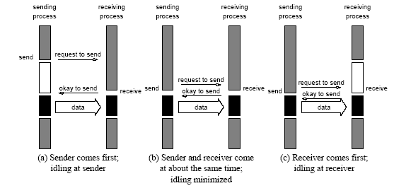
Non-Buffered Blocking
Message Passing Operations
Handshake for a blocking non-buffered send/receive operation.
It is easy to see that in cases where sender and receiver do not
reach communication point at similar times, there can be considerable idling overheads.

Slide 100
Buffered Blocking
Message Passing Operations
A simple solution to the idling and deadlocking problem outlined above is to rely on buffers at the sending and receiving ends.
The sender simply copies the data into the designated buffer and returns after the copy operation has been completed.
The data must be buffered at the receiving end as well.
Buffering trades off idling overhead for buffer copying overhead.

Slide 101
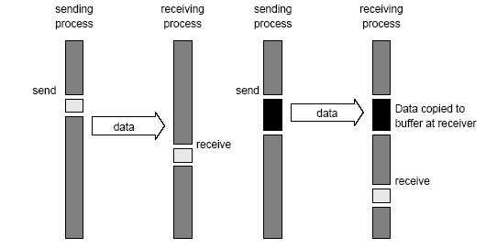
Buffered Blocking
Message Passing Operations
Blocking buffered transfer protocols: (a) in the presence of
communication hardware with buffers at send and receive ends; and (b) in the absence of communication hardware, sender interrupts receiver and deposits data in buffer at receiver end.

Slide 102
Buffered Blocking
Message Passing Operations
Bounded buffer sizes can have signicant impact on performance.
P0 P1
for (i = 0; i < 1000; i++){ for (i = 0; i < 1000; i++){
produce_data(&a); receive(&a, 1, 0);
send(&a, 1, 1); consume_data(&a);
} }
What if consumer was much slower than producer?

Slide 103
Buffered Blocking
Message Passing Operations
Deadlocks are still possible with buffering since receive
operations block.
P0 P1
receive(&a, 1, 1); receive(&a, 1, 0);
send(&b, 1, 1); send(&b, 1, 0);

Slide 104
Non-Blocking
Message Passing Operations
The programmer must ensure semantics of the send and receive.
This class of non-blocking protocols returns from the send or receive operation before it is semantically safe to do so.
Non-blocking operations are generally accompanied by a check-status operation.
When used correctly, these primitives are capable of overlapping communication overheads with useful computations.
Message passing libraries typically provide both blocking and non-blocking primitives.

Slide 105
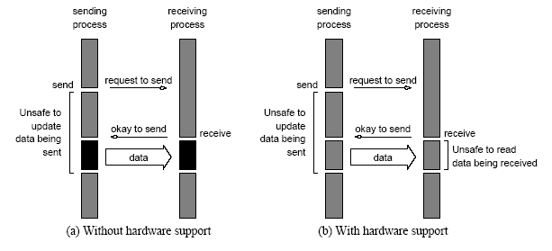
Non-Blocking
Message Passing Operations
Non-blocking non-buffered send and receive operations (a) in
absence of communication hardware; (b) in presence of
communication hardware.

Slide 106
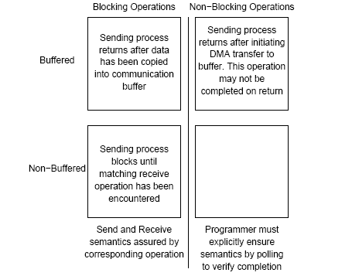
Send and Receive Protocols
Space of possible protocols for send and receive operations.

Slide 107
MPI: the Message Passing Interface
MPI defines a standard library for message-passing that can be used to develop portable message-passing programs using either C or Fortran.
The MPI standard defines both the syntax as well as the semantics of a core set of library routines.
Vendor implementations of MPI are available on almost all commercial parallel computers.
It is possible to write fully-functional message-passing programs by using only the six routines.

Slide 108
MPI: the Message Passing Interface
The minimal set of MPI routines.
MPI_Init | Initializes MPI.
MPI_Finalize | Terminates MPI.
MPI_Comm_size | Determines the number of processes.
MPI_Comm_rank | Determines the label of calling process.
MPI_Send | Sends a message.
MPI_Recv | Receives a message.

Slide 109
Starting and Terminating the MPI Library
MPI_Init is called prior to any calls to other MPI routines. Its purpose is to initialize the MPI environment.
MPI_Finalize is called at the end of the computation, and it performs various clean-up tasks to terminate the MPI environment.
The prototypes of these two functions are:
int MPI_Init(int *argc, char ***argv)
int MPI_Finalize()
MPI_Init also strips off any MPI related command-line arguments.
All MPI routines, data-types, and constants are prefixed by “MPI_”. The return code for successful completion is MPI_SUCCESS.

Slide 110
Communicators
A communicator defines a communication domain - a set of processes that are allowed to communicate with each other.
Information about communication domains is stored in variables of type MPI_Comm.
Communicators are used as arguments to all message transfer MPI routines.
A process can belong to many different (possibly overlapping) communication domains.
MPI defines a default communicator called MPI_COMM_WORLD which includes all the processes.

Slide 111
Querying Information
The MPI_Comm_size and MPI_Comm_rank functions are used to determine the number of processes and the label of the calling process, respectively.
The calling sequences of these routines are as follows:
int MPI_Comm_size(MPI_Comm comm, int *size)
int MPI_Comm_rank(MPI_Comm comm, int *rank)
The rank of a process is an integer that ranges from zero up to the size of the communicator minus one.

Slide 112
Our First MPI Program
#include <mpi.h>
main(int argc, char *argv[])
{
int npes, myrank;
MPI_Init(&argc, &argv);
MPI_Comm_size(MPI_COMM_WORLD, &npes);
MPI_Comm_rank(MPI_COMM_WORLD, &myrank);
printf("From process %d out of %d, Hello World!\n",
myrank, npes);
MPI_Finalize();
}

Slide 113
Sending and Receiving Messages
The basic functions for sending and receiving messages in MPI are the MPI_Send and MPI_Recv, respectively.
The calling sequences of these routines are as follows:
int MPI_Send(void *buf, int count, MPI_Datatype datatype, int dest, int tag, MPI_Comm comm)
int MPI_Recv(void *buf, int count, MPI_Datatype datatype, int source, int tag, MPI_Comm comm, MPI_Status *status)
MPI provides equivalent datatypes for all C datatypes. This is done for portability reasons.
The datatype MPI_BYTE corresponds to a byte (8 bits) and MPI_PACKED corresponds to a collection of data items that has been created by packing non-contiguous data.
The message-tag can take values ranging from zero up to the MPI defined constant MPI_TAG_UB.

Slide 114
MPI Datatypes
MPI Datatype | C Datatype
MPI_CHAR | signed char
MPI_SHORT | signed short int
MPI_INT | signed int
MPI_LONG | signed long int
MPI_UNSIGNED_CHAR | unsigned char
MPI_UNSIGNED_SHORT | unsigned short int
MPI_UNSIGNED | unsigned int
MPI_UNSIGNED_LONG | unsigned long int
MPI_FLOAT | float
MPI_DOUBLE | double
MPI_LONG_DOUBLE | long double
MPI_BYTE
MPI_PACKED

Slide 115
Sending and Receiving Messages
MPI allows specification of wildcard arguments for both source and tag.
If source is set to MPI_ANY_SOURCE, then any process of the communication domain can be the source of the message.
If tag is set to MPI_ANY_TAG, then messages with any tag are accepted.
On the receive side, the message must be of length equal to or less than the length field specified.

Slide 116
Sending and Receiving Messages
On the receiving end, the status variable can be used to get information about the MPI_Recv operation.
The corresponding data structure contains:
  typedef struct MPI_Status {
  int MPI_SOURCE;
  int MPI_TAG;
  int MPI_ERROR; };
The MPI_Get_count function returns the precise count of data items received.
  int MPI_Get_count(MPI_Status *status, MPI_Datatype datatype, int *count)

Slide 117
Avoiding Deadlocks
Consider:
int a[10], b[10], myrank;
MPI_Status status;
...
MPI_Comm_rank(MPI_COMM_WORLD, &myrank);
if (myrank == 0) {
MPI_Send(a, 10, MPI_INT, 1, 1, MPI_COMM_WORLD);
MPI_Send(b, 10, MPI_INT, 1, 2, MPI_COMM_WORLD);
}
else if (myrank == 1) {
MPI_Recv(b, 10, MPI_INT, 0, 2, MPI_COMM_WORLD);
MPI_Recv(a, 10, MPI_INT, 0, 1, MPI_COMM_WORLD);
}
...
If MPI_Send is blocking, there is a deadlock.

Slide 118
Avoiding Deadlocks
Consider the following piece of code, in which process i sends a message to process i + 1 (modulo the number of processes) and receives a message from process i - 1 (module the number of processes).
int a[10], b[10], npes, myrank;
MPI_Status status;
...
MPI_Comm_size(MPI_COMM_WORLD, &npes);
MPI_Comm_rank(MPI_COMM_WORLD, &myrank);
MPI_Send(a, 10, MPI_INT, (myrank+1)%npes, 1, MPI_COMM_WORLD);
MPI_Recv(b, 10, MPI_INT, (myrank-1+npes)%npes, 1, MPI_COMM_WORLD);
...
Once again, we have a deadlock if MPI_Send is blocking.

Slide 119
Avoiding Deadlocks
We can break the circular wait to avoid deadlocks as follows:
int a[10], b[10], npes, myrank;
MPI_Status status;
...
MPI_Comm_size(MPI_COMM_WORLD, &npes);
MPI_Comm_rank(MPI_COMM_WORLD, &myrank);
if (myrank%2 == 1) {
MPI_Send(a, 10, MPI_INT, (myrank+1)%npes, 1, MPI_COMM_WORLD);
MPI_Recv(b, 10, MPI_INT, (myrank-1+npes)%npes, 1, MPI_COMM_WORLD);
}
else {
MPI_Recv(b, 10, MPI_INT, (myrank-1+npes)%npes, 1, MPI_COMM_WORLD);
MPI_Send(a, 10, MPI_INT, (myrank+1)%npes, 1, MPI_COMM_WORLD);
}
...

Slide 120
Sending and Receiving
Messages Simultaneously
To exchange messages, MPI provides the following function:
int MPI_Sendrecv(void *sendbuf, int sendcount,
MPI_Datatype senddatatype, int dest, int sendtag, void *recvbuf, int recvcount, MPI_Datatype recvdatatype, int source, int recvtag, MPI_Comm comm, MPI_Status *status)
The arguments include arguments to the send and receive
functions. If we wish to use the same buffer for both send and
receive, we can use:
int MPI_Sendrecv_replace(void *buf, int count,
MPI_Datatype datatype, int dest, int sendtag,
int source, int recvtag, MPI_Comm comm,
MPI_Status *status)

Slide 121
Topologies and Embeddings
MPI allows a programmer to organize processors into logical k-d meshes.
The processor ids in MPI_COMM_WORLD can be mapped to other communicators (corresponding to higher-dimensional meshes) in many ways.
The goodness of any such mapping is determined by the interaction pattern of the underlying program and the topology of the machine.
MPI does not provide the programmer any control over these mappings

Slide 122
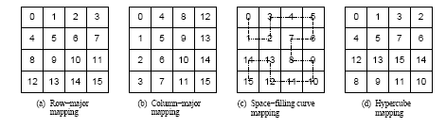
Topologies and Embeddings
Different ways to map a set of processes to a two-dimensional
grid. (a) and (b) show a row- and column-wise mapping of these
processes, (c) shows a mapping that follows a space-lling curve
(dotted line), and (d) shows a mapping in which neighboring
processes are directly connected in a hypercube.

Slide 123
Creating and Using
Cartesian Topologies
We can create cartesian topologies using the function:
  int MPI_Cart_create(MPI_Comm comm_old, int ndims,
  int *dims, int *periods, int reorder, MPI_Comm *comm_cart)
This function takes the processes in the old communicator and creates a new communicator with dims dimensions.
Each processor can now be identified in this new cartesian topology by a vector of dimension dims.

Slide 124
Creating and Using
Cartesian Topologies
Since sending and receiving messages still require (one-dimensional) ranks, MPI provides routines to convert ranks to cartesian coordinates and vice-versa.
  int MPI_Cart_coord(MPI_Comm comm_cart, int rank, int maxdims, int *coords)
  int MPI_Cart_rank(MPI_Comm comm_cart, int *coords, int *rank)
The most common operation on cartesian topologies is a shift. To determine the rank of source and destination of such shifts, MPI provides the following function:
  int MPI_Cart_shift(MPI_Comm comm_cart, int dir, int s_step, int *rank_source, int *rank_dest)

Slide 125
Overlapping Communication with Computation
In order to overlap communication with computation, MPI provides a pair of functions for performing non-blocking send and receive operations.
  int MPI_Isend(void *buf, int count, MPI_Datatype datatype,
  int dest, int tag, MPI_Comm comm,
  MPI_Request *request)
  int MPI_Irecv(void *buf, int count, MPI_Datatype datatype,
  int source, int tag, MPI_Comm comm,
  MPI_Request *request)
These operations return before the operations have been completed. Function MPI_Test tests whether or not the non-blocking send or receive operation identified by its request has finished.
  int MPI_Test(MPI_Request *request, int *flag,
  MPI_Status *status)
MPI_Wait waits for the operation to complete.
  int MPI_Wait(MPI_Request *request, MPI_Status *status)

Slide 126
Avoiding Deadlocks
Using non-blocking operations remove most deadlocks. Consider:
int a[10], b[10], myrank;
MPI_Status status;
...
MPI_Comm_rank(MPI_COMM_WORLD, &myrank);
if (myrank == 0) {
MPI_Send(a, 10, MPI_INT, 1, 1, MPI_COMM_WORLD);
MPI_Send(b, 10, MPI_INT, 1, 2, MPI_COMM_WORLD);
}
else if (myrank == 1) {
MPI_Recv(b, 10, MPI_INT, 0, 2, &status, MPI_COMM_WORLD); MPI_Recv(a, 10, MPI_INT, 0, 1, &status, MPI_COMM_WORLD);
}
...
Replacing either the send or the receive operations with non-blocking counterparts fixes this deadlock.

Slide 127
Collective Communication and Computation Operations
MPI provides an extensive set of functions for performing common collective communication operations.
Each of these operations is defined over a group corresponding to the communicator.
All processors in a communicator must call these operations.

Slide 128
Collective Communication Operations
The barrier synchronization operation is performed in MPI using:
  int MPI_Barrier(MPI_Comm comm)
The one-to-all broadcast operation is:
  int MPI_Bcast(void *buf, int count, MPI_Datatype datatype, int source, MPI_Comm comm)
The all-to-one reduction operation is:
  int MPI_Reduce(void *sendbuf, void *recvbuf, int count, MPI_Datatype datatype, MPI_Op op, int target, MPI_Comm comm)

Slide 129
Predefined Reduction Operations
Operation | Meaning | Datatypes
MPI_MAX | Maximum | C integers and floating point
MPI_MIN | Minimum | C integers and floating point
MPI_SUM | Sum | C integers and floating point
MPI_PROD | Product | C integers and floating point
MPI_LAND | Logical AND | C integers
MPI_BAND | Bit-wise AND | C integers and byte
MPI_LOR | Logical OR | C integers
MPI_BOR | Bit-wise OR | C integers and byte
MPI_LXOR | Logical XOR | C integers
MPI_BXOR | Bit-wise XOR | C integers and byte
MPI_MAXLOC | max-min value-location | Data-pairs
MPI_MINLOC | min-min value-location | Data-pairs

Slide 130
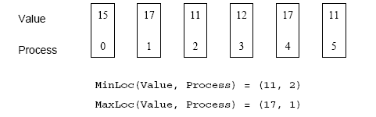
Collective Communication Operations
The operation MPI_MAXLOC combines pairs of values (v_{i}, l_{i}) and returns the pair (v, l) such that v is the maximum among all v_{i} 's and l is the corresponding l_{i} (if there are more than one, it is the smallest among all these l_{i} 's).
MPI_MINLOC does the same, except for minimum value of v_{i}.
An example use of the MPI_MINLOC and MPI_MAXLOC operators.

Slide 131
Collective Communication Operations
MPI datatypes for data-pairs used with the MPI_MAXLOC and MPI_MINLOC reduction operations.
MPI Datatype | C Datatype
MPI_2INT | pair of ints
MPI_SHORT_INT | short and int
MPI_LONG_INT | long and int
MPI_LONG_DOUBLE_INT | long double and int
MPI_FLOAT_INT | float and int
MPI_DOUBLE_INT | double and int

Slide 132
MPI_Reduce
Reduce is a classic concept from functional programming.
Data reduction involves reducing a set of numbers into a smaller set of numbers via a function.
For example, let’s say we have a list of numbers [1, 2, 3, 4, 5]. Reducing this list of numbers with the sum function would produce sum([1, 2, 3, 4, 5]) = 15.
Similarly, the multiplication reduction would yield multiply([1, 2, 3, 4, 5]) = 120

Slide 133
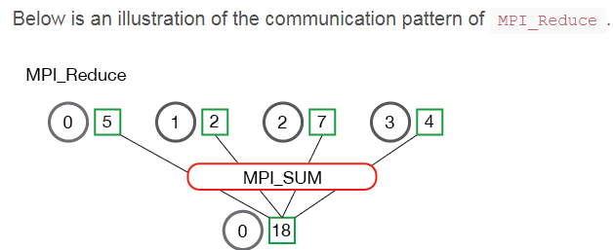
MPI_Reduce
MPI_Reduce( void* send_data, void* recv_data, int count, MPI_Datatype datatype, MPI_Op op, int root, MPI_Comm communicator)

Slide 134
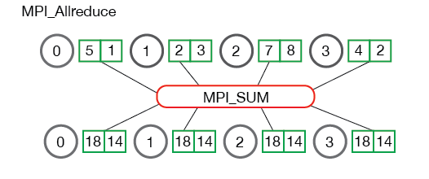
MPI_Allreduce
If the result of the reduction operation is needed by all processes, MPI provides:
  int MPI_Allreduce(void *sendbuf, void *recvbuf,
  int count, MPI_Datatype datatype, MPI_Op op, MPI_Comm comm)

Slide 135
Collective Communication Operations
If the result of the reduction operation is needed by all processes, MPI provides:
  int MPI_Allreduce(void *sendbuf, void *recvbuf,
  int count, MPI_Datatype datatype, MPI_Op op, MPI_Comm comm)
To compute prefix-sums, MPI provides:
  int MPI_Scan(void *sendbuf, void *recvbuf, int count, MPI_Datatype datatype, MPI_Op op,
  MPI_Comm comm)

Slide 136
Collective Communication Operations
The gather operation is performed in MPI using:
  int MPI_Gather(void *sendbuf, int sendcount,
  MPI_Datatype senddatatype, void *recvbuf,
  int recvcount, MPI_Datatype recvdatatype,
  int target, MPI_Comm comm)
MPI also provides the MPI_Allgather function in which the data are gathered at all the processes.
  int MPI_Allgather(void *sendbuf, int sendcount, MPI_Datatype senddatatype, void *recvbuf,
  int recvcount, MPI_Datatype recvdatatype,
  MPI_Comm comm)
The corresponding scatter operation is:
  int MPI_Scatter(void *sendbuf, int sendcount,
  MPI_Datatype senddatatype, void *recvbuf,
  int recvcount, MPI_Datatype recvdatatype,
  int source, MPI_Comm comm)

Slide 137
MPI_Scatter
MPI_Scatter is a collective routine that is very similar to MPI_Bcast .
MPI_Scatter involves a designated root process sending data to all processes in a communicator.
The primary difference between MPI_Bcast and MPI_Scatter is small but important.
MPI_Bcast sends the same piece of data to all processes while MPI_Scatter sends chunks of an array to different processes. Check out the illustration below for further clarification.

Slide 138

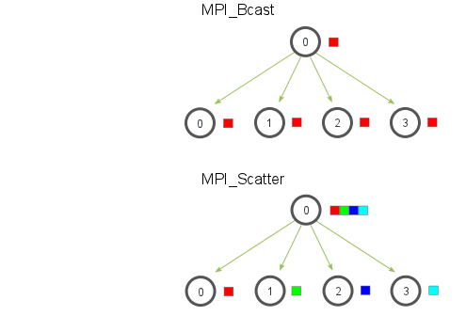
MPI_Scatter

Slide 139
MPI_Gather
MPI_Gather is the inverse of MPI_Scatter. Instead of spreading elements from one process to many processes, MPI_Gather takes elements from many processes and gathers them to one single process.
This routine is highly useful to many parallel algorithms, such as parallel sorting and searching. Below is a simple illustration of this algorithm.

Slide 140
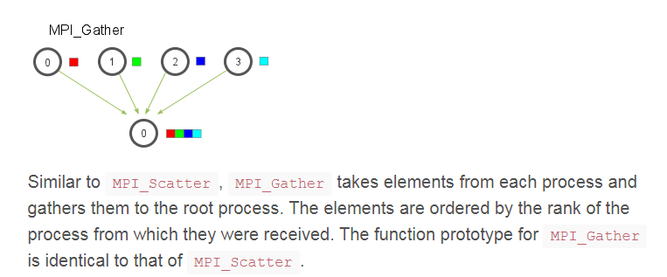
MPI_Gather

Slide 141
MPI_Allgather
So far, we have covered two MPI routines that perform many-to-one or one-to-many communication patterns, which simply means that many processes send/receive to one process.
Oftentimes it is useful to be able to send many elements to many processes (i.e. a many-to-many communication pattern).
MPI_Allgather has this characteristic.

Slide 142
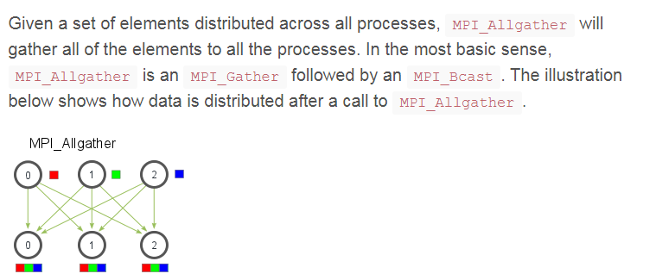
MPI_Allgather

Slide 143
Collective Communication Operations
The all-to-all personalized communication operation is performed by:
  int MPI_Alltoall(void *sendbuf, int sendcount, MPI_Datatype senddatatype, void *recvbuf,
  int recvcount, MPI_Datatype recvdatatype, MPI_Comm comm)
Using this core set of collective operations, a number of programs can be greatly simplified.

Slide 144
Groups and Communicators
In many parallel algorithms, communication operations need to be restricted to certain subsets of processes.
MPI provides mechanisms for partitioning the group of processes that belong to a communicator into subgroups each corresponding to a different communicator.
The simplest such mechanism is:
  int MPI_Comm_split(MPI_Comm comm, int color, int key, MPI_Comm *newcomm)
This operation groups processors by color and sorts resulting groups on the key.

Slide 145
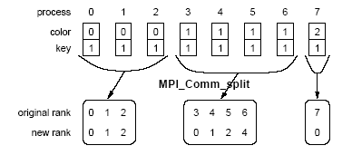
Groups and Communicators
Using MPI_Comm_split to split a group of processes in a communicator into subgroups.

Slide 146
Groups and Communicators
In many parallel algorithms, processes are arranged in a virtual grid, and in different steps of the algorithm, communication needs to be restricted to a different subset of the grid.
MPI provides a convenient way to partition a Cartesian topology to form lower-dimensional grids:
  int MPI_Cart_sub(MPI_Comm comm_cart, int *keep_dims, MPI_Comm *comm_subcart)
If keep_dims[i] is true (non-zero value in C) then the ith dimension is retained in the new sub-topology.
The coordinate of a process in a sub-topology created by MPI_Cart_sub can be obtained from its coordinate in the original topology by disregarding the coordinates that correspond to the dimensions that were not retained.

Slide 147
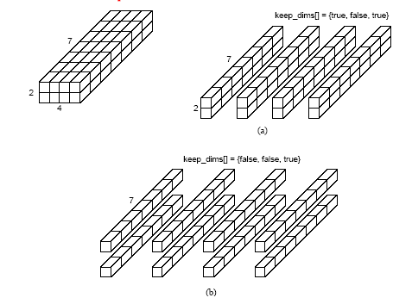
Groups and Communicators
Splitting a Cartesian topology of size 2 x 4 x 7 into (a) four
subgroups of size 2 x 1 x 7, and (b) eight subgroups of size 1 x 1 x 7.

